Slide 1
PROJECT PRESENTATION
Presented BY
VARA LAKSHMI HARSHITHA PEDIREDDi

Slide 2
Topic : Machine Learning
CONTENTS :
1.Introduction
2.How does M.L Working?
3.Why is M.L Important?
4.Types of M.L?
5.Supervised Learning?
6.Two types of Supervised Learning?
7.Types of Regression?

Slide 3
INTRODUCTION:
Machine Learning introduced by “GEOFFREY EVEREST HINTON” Born by 6 th December 1947 is a British –Canadian cognitive psychologist and computer scientist .
FIELDS : Machine learning ,Artificial Intelligence, object recognition, neural networks and object recognition.
Machine learning is a subfield of artificial intelligence (AI). The goal of machine learning generally is to understand the structure of data and fit that data into models that can be understood and utilized by people. It is defined as capability of a machine to intimate intelligence of human behavior .It improves future decision making.
Example:
Face detection : Identify faces in Images. [(or) indicates if a face is present].

Slide 4
How does M.L Working?
The Ultimate Goal of M.L is to design algorithms that automatically help a system gather data and use that data to learn more.

Slide 5
Types of Machine Learning?
3 Types of Machine Learning:
1. Supervised Learning.
2.Unsupervised Learning.
3. Reinforcement Learning.

Slide 6
Why is M.L Important?
Machine Learning is important because it gives enterprises a view of trends in customer behavior and business operational patterns, as well as supports the development of new products.

Slide 7
Supervised Learning:
1.In Supervised learning input and output variables are provided to train model.
2. Supervised learning is an approach to creating Artificial intelligence, where a computer algorithms is trained on input data that has been labeled for a particular output .
3.Algorithm supports : supports Regression algorithms, instance based algorithms , classification algorithms , neural networks and decision trees.
4.Primary Goal : Train the model to predict output when presented with new inputs .

Slide 8
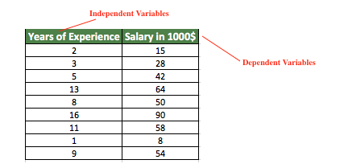
Two types of Unsupervised learning:
Regression.
Classification.
Regression: To predict the outcome of a given sample where the output variable is in the form of real values .

Slide 9
Types of Regression
1.Decision Tree.
2.Linear Regression.
3. Logistic Regression.
LINEAR REGRESSION : Linear Regression is an ML algorithm used for supervised learning. Linear regression performs the task to predict a dependent variable(target) based on the given independent variable(s). So, this regression technique finds out a linear relationship between a dependent variable and the other given independent variables

Slide 10
THANK YOU

